Slide 1
INFO 511: Final Project
Data Science Job Trends

Slide 2
Dataset
The dataset used for this project is "Data Science Job" dataset from Kaggle.
Publicly available data, no privacy concerns.
contains job seekers details, including education, experience, training hours and city development index.

Slide 3
Research Questions
How does city development index influence job-seeking behaviour in the data science field?
What are the key trends in experience levels, education, and major disciplines among data science job seekers?
How does training impact job-seeking trends in data science?

Slide 4
Data Pre-processing and Transformation
Handled missing values by filling numerical columns (experience, training hours, city development index) with median values.
Categorical columns (gender,, education level, major discipline) were filled with mode values.
Removed duplicate records to avoid bias in the analysis.

Slide 5
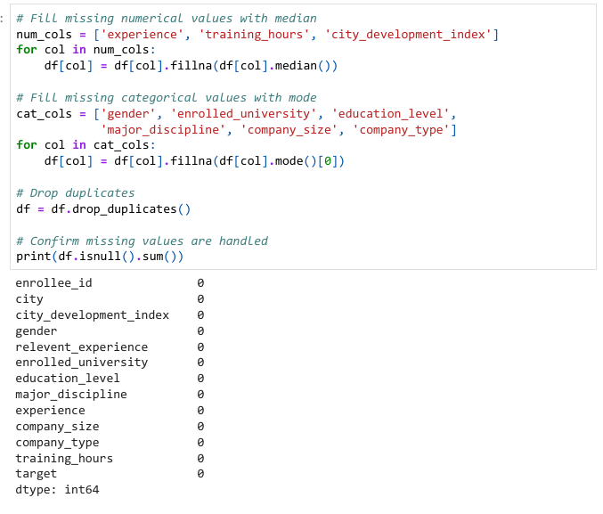

Slide 6
Exploratory Data Analysis (EDA):
Box Plot: City Development Index vs Job-Seeking Intent
Histogram: Distribution of Experience Among Job Seekers
Bar Chart: Education Level of Job Seekers
Bar Chart: Major Discipline of Job Seekers
Histogram: Distribution of Training Hours
Box Plot: Training Hours vs Job-Seeking Intent

Slide 7
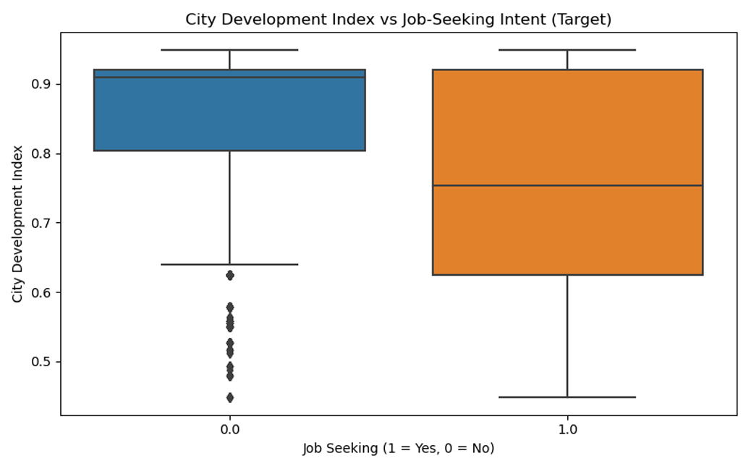

Slide 8
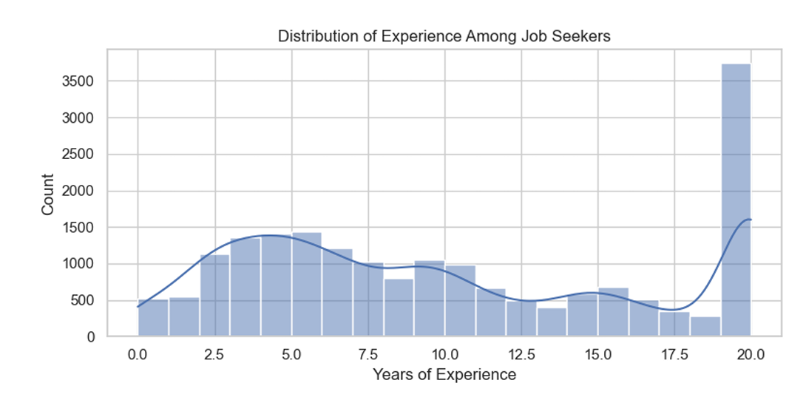

Slide 9
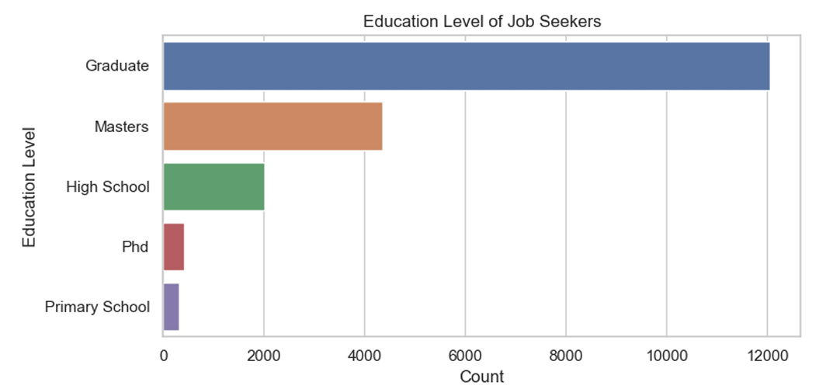

Slide 10
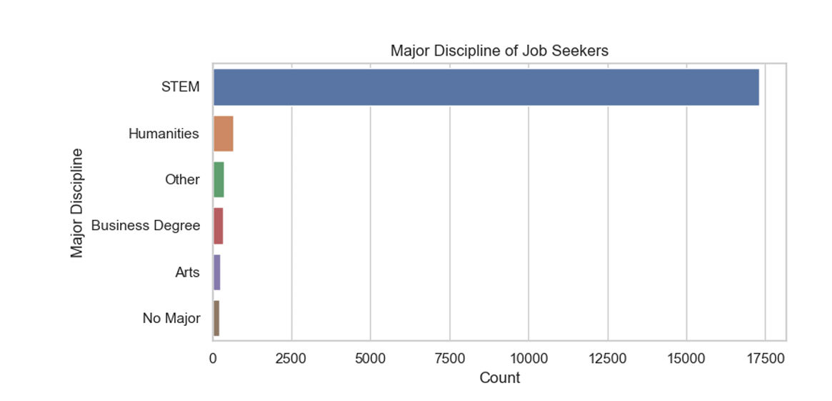

Slide 11
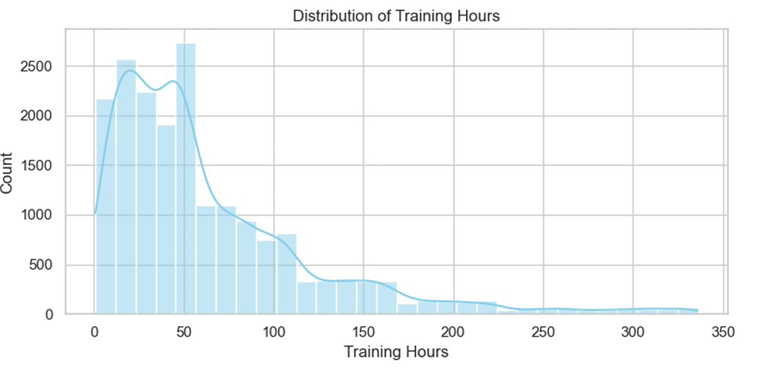

Slide 12
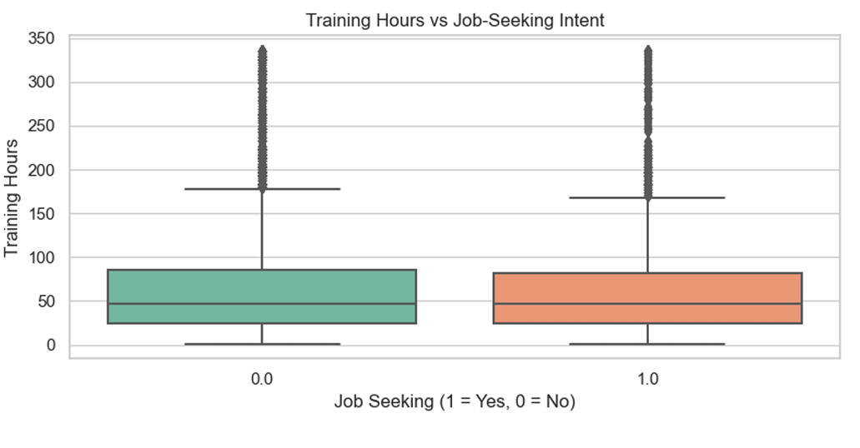

Slide 13
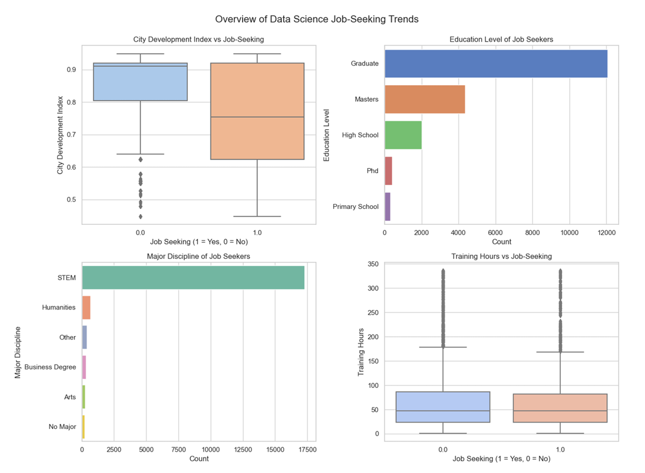

Slide 14
Findings:
Candidates from high city development index areas are more likely to be actively seeking jobs.
Graduate (likely Bachelor’s) and Master’s degree holders are the most common among job seekers.
The majority of job seekers come from STEM fields — especially Computer Science, Engineering, Mathematics, and Statistics.
Training hours are evenly split between candidates with high job-seeking intent and no job seeking intent in DS.
Most job seekers have either very low (fresh graduates) or moderate (mid-level) experience.

